Slide 1
Introduction to HDF5
Elena Pourmal
Scot Breitenfeld
The HDF Group
https://hdfgroup.org

Slide 2
Tutorial Goals and Structure
Goals
Help you to start learning HDF5
Give you an insight into parallel I/O
Tutorial structure
What is HDF5? (first hour)
What is parallel HDF5 and how to use it in HPC environment? (second hour)
Concepts, demos, and hands-on
Questions are welcome during the presentation!

Slide 3
Why HDF5?
Have you ever asked yourself:
Where is my data?
How will (do, did) I organize my data?
How will I share my data?
What did I write into this file a week, a month, a year ago while working on my thesis?
How will I deal with one-file-per-processor in the Petascale (Exascale, …scale) era?
Do I need to be an “HPC pro” to do my research?

Slide 4
Why HDF5?
HDF5 hides all complexity so you can concentrate on Science
Organize data in a file
Optimized I/O to single shared file
Domain-specific libraries and tools, big codes built on HDF5
Data analysis and Visualization (VisIt, ParaView)
Weather and Climate (netCDF-4)
CFD (CGNS)
Matlab, Mathematica, Python (h5py), R

Slide 5
Introduction to HDF5 Part I
Introduce you to HDF5
HDF5 data model
HDF5 programming model
Tools and examples

Slide 6
What is HDF5?

Slide 7
What is HDF5?
HDF5 == Hierarchical Data Format version 5
Open file format
Designed for high volume or complex data
Open source software
Works with data in the format
A data model
Structures for data organization and specification

Slide 8
Rationale behind HDF5
HDF5 is designed for
Big Data - high volume and/or complex heterogeneous data
Every size and type of system (portable, shareable)
Flexible, efficient storage and I/O
Enabling applications to evolve in their use of HDF5 and to accommodate new models
Supporting long-term data preservation

Slide 9
HDF5 Data model

Slide 10
HDF5 Data Model
Dataset
Link
Group
HDF5 Objects
Datatype
Attribute
Dataspace
File
a.k.a. HDF5 Abstract Data Model a.k.a. HDF5 Logical Data Model

Slide 11
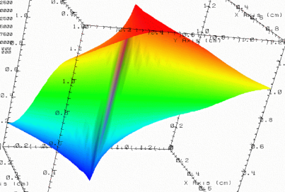


HDF5 File
lat | lon | temp
----|-----|-----
12 | 23 | 3.1
15 | 24 | 4.2
17 | 21 | 3.6
An HDF5 file is a container that holds data objects.
Experiment Notes:
Serial Number: 99378920
Date: 3/13/09
Configuration: Standard 3

Slide 12
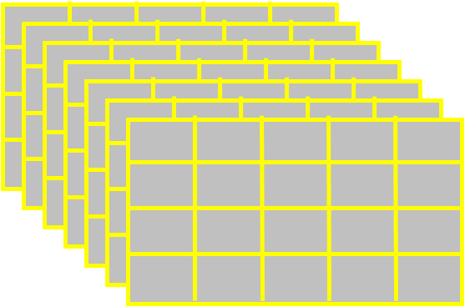
HDF5 Dataset
HDF5 Datatype
Integer 32bit LE
HDF5 Dataspace
Rank
Dimensions
3
Dim_0 = 4
Dim_1 = 5
Dim_2 = 7
Specifications for single data element and array dimensions
Multi-dimensional array of
identically typed data elements
HDF5 datasets organize and contain “raw data values.”
HDF5 datatype describes individual data elements.
HDF5 dataspace describes the logical layout of the data elements.

Slide 13
HDF5 Dataspace
Describes the logical layout of the elements in an HDF5 dataset
NULL
no elements
Scalar
single element
Simple array (most common)
multiple elements organized in a rectangular array
rank = number of dimensions
dimension sizes = number of elements in each dimension
maximum number of elements in each dimension
may be fixed or unlimited
Extreme Scale Computing Argonne

Slide 14
HDF5 Dataspace
Two roles:
Dataspace contains spatial information
Rank and dimensions
Permanent part of dataset definition
Partial I/0: Dataspace describes application’s data buffer and data elements participating in I/O
Rank = 2
Dimensions = 4x6
Rank = 1
Dimension = 10

Slide 15
HDF5 Datatypes
Describe individual data elements in an HDF5 dataset
Wide range of datatypes supported
Integer
Float
Enum
Array
User-defined (e.g., 13-bit integer)
Variable length types (e.g., strings)
Compound (similar to C structs)
Many more …
Extreme Scale Computing Argonne

Slide 16
HDF5 Dataset
3
5
12
Datatype: 32-bit Integer
Dataspace: Rank = 2 Dimensions = 5 x 3

Slide 17
HDF5 Dataset with Compound Datatype
3
5
V
V
V
V V V
V V V
int16
char
int32
2x3x2 array of float32
Compound
Datatype:
Dataspace: Rank = 2 Dimensions = 5 x 3

Slide 18
How data is stored?
Buffer in memory
Data in the file
Data elements stored physically adjacent to each other
Contiguous
(default)
Better access time for subsets; extendible
Chunked
Chunked & Compressed
Improves storage efficiency, transmission speed

Slide 19
HDF5 Attributes
Typically contain user metadata
Have a name and a value
Attributes “decorate” HDF5 objects
Value is described by a datatype and a dataspace
Analogous to a dataset, but do not support partial I/O operations; nor can they be compressed or extended

Slide 20
HDF5 File
lat | lon | temp
----|-----|-----
12 | 23 | 3.1
15 | 24 | 4.2
17 | 21 | 3.6
An HDF5 file is a smart container that holds data objects.
Experiment Notes:
Serial Number: 99378920
Date: 3/13/09
Configuration: Standard 3

Slide 21



HDF5 Groups and Links
HDF5 groups and links organize data objects.
Every HDF5 file
has a root group
/
Experiment Notes:
Serial Number: 99378920
Date: 3/13/09
Configuration: Standard 3
Parameters
10;100;1000
Viz
SimOut
lat | lon | temp
----|-----|-----
12 | 23 | 3.1
15 | 24 | 4.2
17 | 21 | 3.6
Timestep
36,000

Slide 22
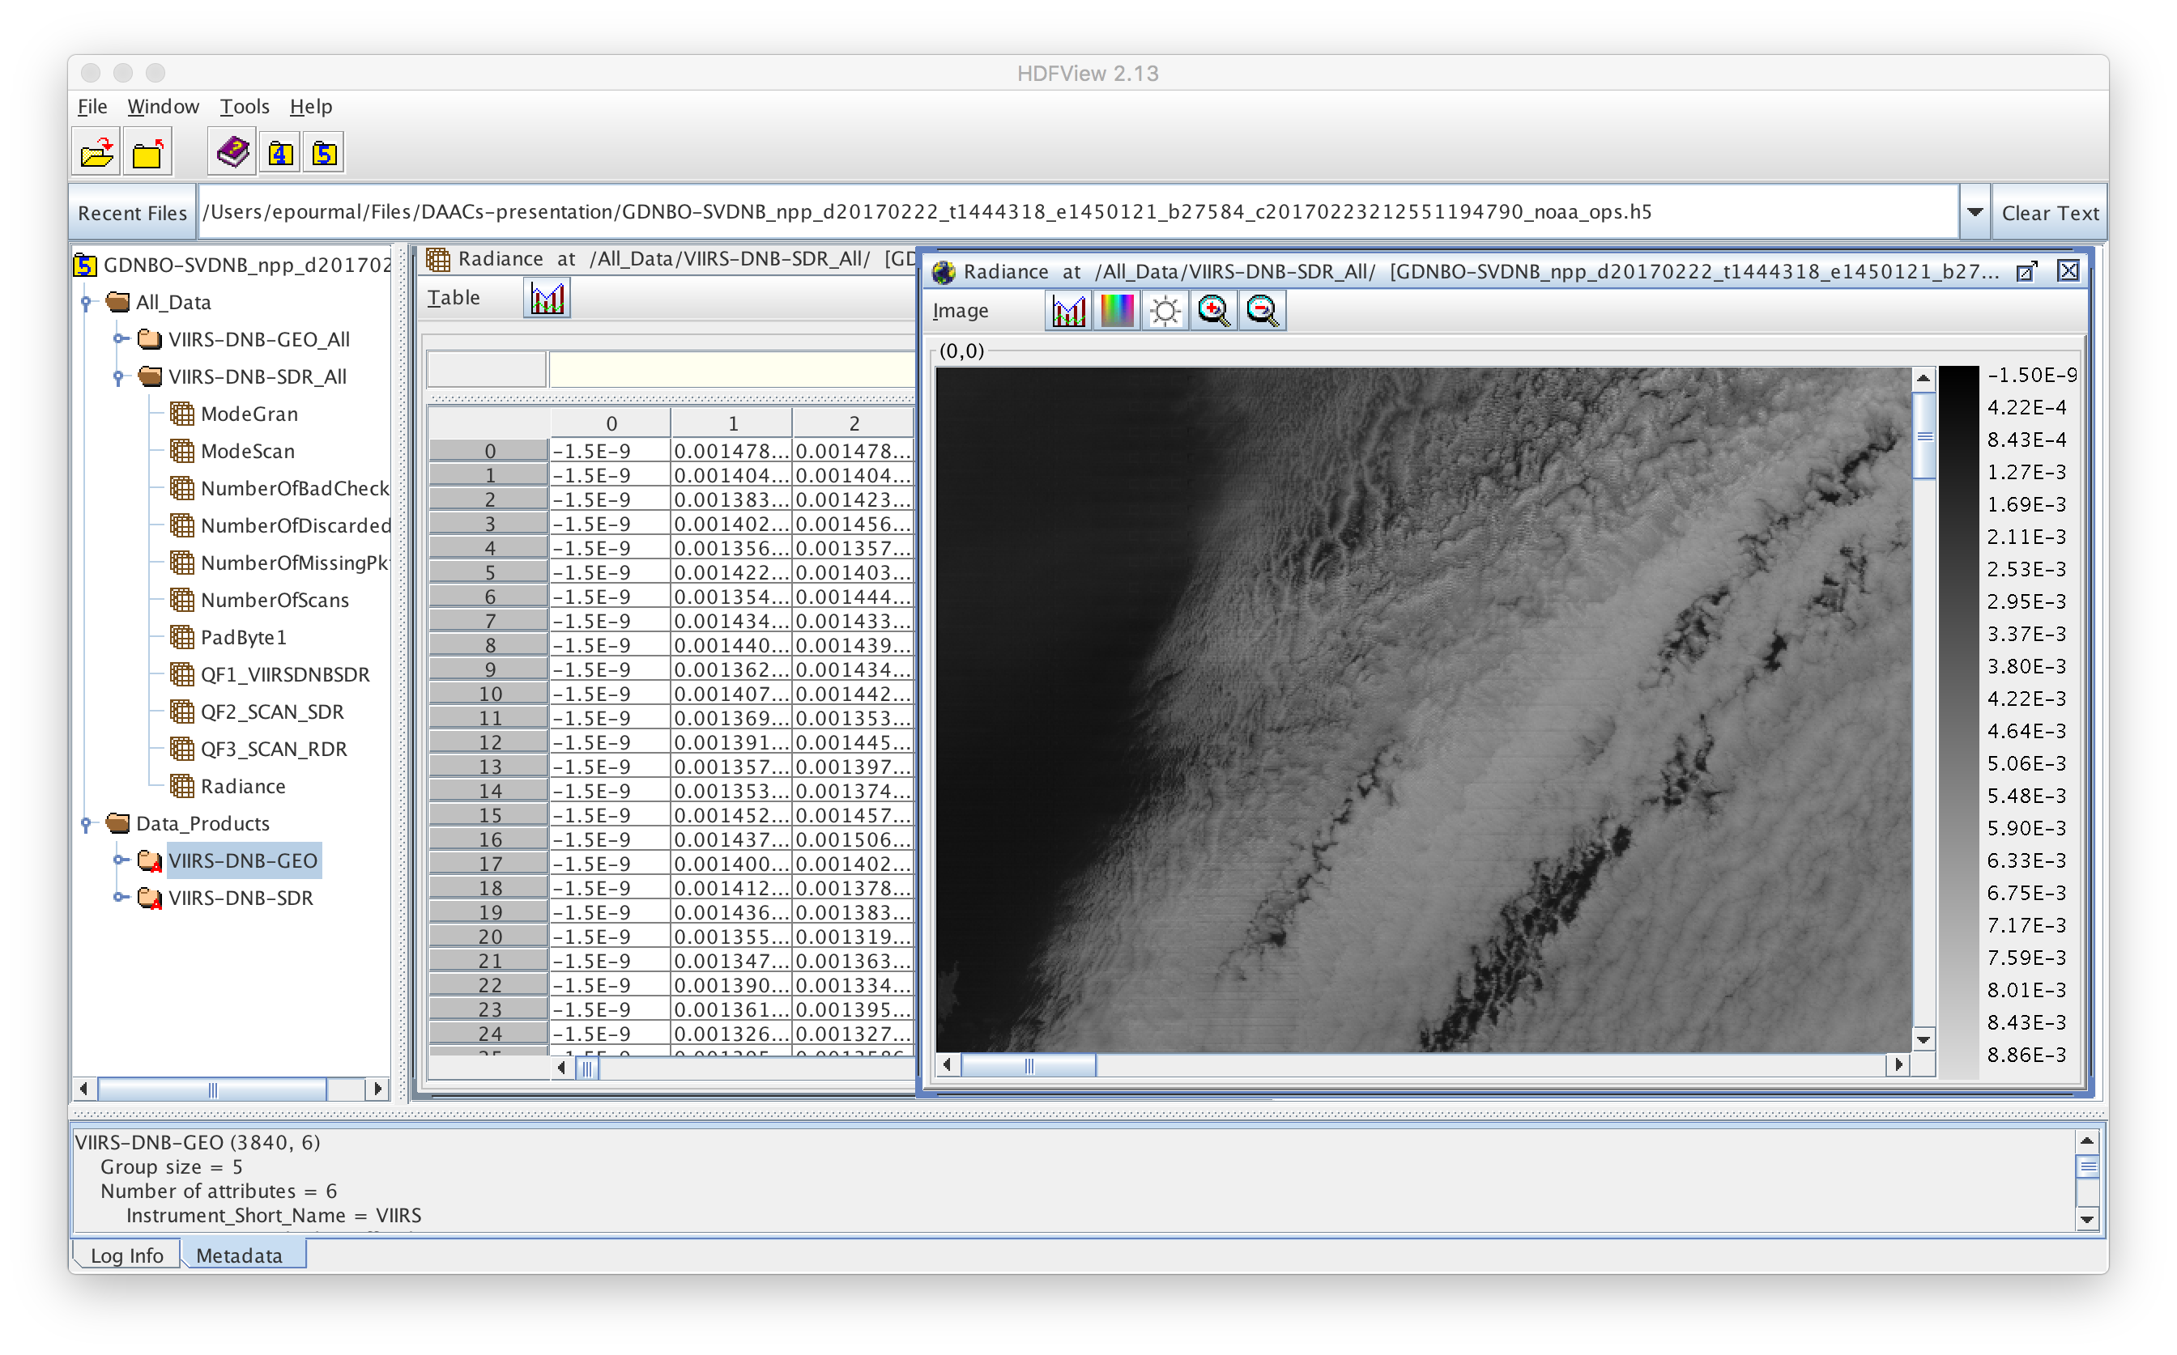
HDFView: Example of HDF5 file

Slide 23
HDF5 software

Slide 24
HDF5 Home Page
HDF5 home page: http://hdfgroup.org/HDF5/
Latest release: HDF5 1.8.20, HDF5 1.10.1
HDF5 source code:
Written in C, and includes optional C++, Fortran, Java APIs, and High-Level APIs
Contains command-line utilities (h5dump, h5repack, h5diff, ..) and compile scripts
HDF5 pre-built binaries:
When possible, include C, C++, F90, and High-Level libraries. Check ./lib/libhdf5.settings file.
Built with and require the SZIP and ZLIB external libraries

Slide 25
HDF5 Software Layers and Storage
Apps
H5Part
High Level
APIs
API
netCDF-4
Tools
H5py
R
HDFview
Java Interface
HDF5 Library
Language
Interfaces
HDF5 Data Model Objects Groups, Datasets, Attributes, …
Tunable Properties Chunk Size, I/O Driver, …
C, Fortran, C++
Internals
Memory Mgmt
Datatype Conversion
Filters
Chunked Storage
Version Compatibility
and so on…
Virtual File Layer
Posix I/O
Split Files
Custom
MPI I/O
I/O Drivers
Storage
HDF5 File Format
File on Parallel Filesystem
?
File
Split Files
Other

Slide 26
Useful Tools For New Users
h5dump:
Tool to “dump” or display contents of HDF5 files
h5cc, h5c++, h5fc:
Scripts to compile applications
HDFView:
Java browser to view HDF5 files
http://www.hdfgroup.org/hdf-java-html/hdfview/
HDF5 Examples (C, Fortran, Java, Python, Matlab)
http://www.hdfgroup.org/ftp/HDF5/examples/

Slide 27
HDF5 Programming model and Api

Slide 28
General Programming Paradigm
Object is opened or created
Object is accessed, possibly many times
Object is closed
Properties of object are optionally defined
Creation properties (e.g., use chunking storage)
Access properties

Slide 29
The General HDF5 API
C, Fortran, Java, C++, and .NET bindings
IDL, MATLAB, Python (H5Py, PyTables)
C routines begin with prefix H5?
? is a character corresponding to the type of object the function acts on
Example Functions:
H5D : Dataset interface e.g., H5Dread
H5F : File interface e.g., H5Fopen
H5S : dataSpace interface e.g., H5Sclose

Slide 30

The HDF5 API
For flexibility, the API is extensive
300+ functions
This can be daunting… but there is hope
A few functions can do a lot
Start simple
Build up knowledge as more features are needed
Victorinox Swiss Army Cybertool 34

Slide 31
Basic Functions
H5Fcreate (H5Fopen) create (open) File
H5Screate_simple/H5Screate create dataSpace
H5Dcreate (H5Dopen) create (open) Dataset
H5Dread, H5Dwrite access Dataset
H5Dclose close Dataset
H5Sclose close dataSpace
H5Fclose close File

Slide 32
Other Common Functions
DataSpaces: H5Sselect_hyperslab (Partial I/O)
H5Sselect_elements (Partial I/O)
H5Dget_space
Groups: H5Gcreate, H5Gopen, H5Gclose
Attributes: H5Acreate, H5Aopen_name, H5Aclose, H5Aread, H5Awrite
Property lists: H5Pcreate, H5Pclose
H5Pset_chunk, H5Pset_deflate

Slide 33
C examples

Slide 34

How to compile HDF5 applications
h5cc – HDF5 C compiler command
h5fc – HDF5 F90 compiler command
h5c++ - HDF5 C++ compiler command
To compile:
h5cc h5prog.c
h5fc h5prog.f90
h5c++ h5prog.cpp

Slide 35
Code: Create a File
hid_t file_id;
herr_t status;
file_id = H5Fcreate("file.h5", H5F_ACC_TRUNC,
H5P_DEFAULT, H5P_DEFAULT);
status = H5Fclose (file_id);
“/” (root)
Note: Return codes not checked for errors in code samples.

Slide 36
Example: Create a Group
“/” (root)
A
B
4x6 array of integers
file.h5

Slide 37
Code: Create a Dataset
1 hid_t file_id, dataset_id, dataspace_id;
2 hsize_t dims[2];
3 herr_t status;
4 file_id = H5Fcreate (”file.h5", H5F_ACC_TRUNC,
H5P_DEFAULT, H5P_DEFAULT);
5 dims[0] = 4;
6 dims[1] = 6;
dataspace_id = H5Screate_simple (2, dims, NULL);
8 dataset_id = H5Dcreate (file_id,”A",H5T_STD_I32BE,
dataspace_id, H5P_DEFAULT, H5P_DEFAULT,
H5P_DEFAULT);
9 status = H5Dclose (dataset_id);
10 status = H5Sclose (dataspace_id);
11 status = H5Fclose (file_id);
“/” (root)
A

Slide 38
Code: Create a Group
hid_t file_id, group_id;
...
/* Open “file.h5” */
file_id = H5Fopen (“file.h5”, H5F_ACC_RDWR, H5P_DEFAULT);
/* Create group "/B" in file. */
group_id = H5Gcreate (file_id,"B", H5P_DEFAULT, H5P_DEFAULT, H5P_DEFAULT);
/* Close group and file. */
status = H5Gclose (group_id);
status = H5Fclose (file_id);

Slide 39
Output of h5dump
h5dump file.h5
HDF5 "file.h5" {
GROUP "/" {
DATASET "A" {
DATATYPE H5T_STD_I32BE
DATASPACE SIMPLE { ( 4, 6 ) / ( 4, 6 ) }
DATA {
(0,0): 0, 0, 0, 0, 0, 0,
(1,0): 0, 0, 0, 0, 0, 0,
(2,0): 0, 0, 0, 0, 0, 0,
(3,0): 0, 0, 0, 0, 0, 0
}
}
GROUP "B" {
}
}
}

Slide 40
Example Code - H5Dwrite
int wdata[4][6];
/* Initialize the dataset. */
for (i = 0; i < 4; i++)
for (j = 0; j < 6; j++)
wdata[i][j] = i * 6 + j + 1;
…..
status = H5Dwrite (dataset_id, H5T_NATIVE_INT, H5S_ALL,H5S_ALL, H5P_DEFAULT, wdata);

Slide 41
Output of h5dump after writing
$ h5dump file.h5
HDF5 "file.h5" {
GROUP "/" {
DATASET "A" {
DATATYPE H5T_STD_I32BE
DATASPACE SIMPLE { ( 4, 6 ) / ( 4, 6 ) }
DATA {
(0,0): 1, 2, 3, 4, 5, 6,
(1,0): 7, 8, 9, 10, 11, 12,
(2,0): 13, 14, 15, 16, 17, 18,
(3,0): 19, 20, 21, 22, 23, 24
}
}
GROUP "B" {
}
}
}

Slide 42
Partial i/o in HDF5

Slide 43
How to write a row?
$ h5dump file.h5
HDF5 "file.h5" {
GROUP "/" {
DATASET "A" {
DATATYPE H5T_STD_I32BE
DATASPACE SIMPLE { ( 4, 6 ) / ( 4, 6 ) }
DATA {
(0,0): 0, 0, 0, 0, 0, 0,
(1,0): 1, 2, 3, 4, 5, 6,
(2,0): 0, 0, 0, 0, 0, 0,
(3,0): 0, 0, 0, 0, 0, 0
}
}
GROUP "B" {
}
}
}

Slide 44
How to Describe a Subset in HDF5?
Before writing and reading a subset of data one has to describe it to the HDF5 Library.
HDF5 APIs and documentation refer to a subset as a “selection” or “hyperslab selection”.
If specified, HDF5 Library will perform I/O on a selection only and not on all elements of a dataset.

Slide 45
Types of Selections in HDF5
Two types of selections
Hyperslab selection
Regular hyperslab
Simple hyperslab
Result of set operations on hyperslabs (union, difference, …)
Point selection
Hyperslab selection is especially important for doing parallel I/O in HDF5 (See Parallel HDF5 Tutorial)

Slide 46
Regular Hyperslab
Collection of regularly spaced blocks of equal size

Slide 47
Simple Hyperslab
Contiguous subset or sub-array

Slide 48
Hyperslab Selection
Result of union operation on three simple hyperslabs

Slide 49
HDF5 Hyperslab Description
Everything is “measured” in number of elements
Start - starting location of a hyperslab (1,1)
Stride - number of elements that separate each block (3,2)
Count - number of blocks (2,6)
Block - block size (2,1)

Slide 50
Simple Hyperslab Description
Two ways to describe a simple hyperslab
As several blocks
Stride – (1,1)
Count – (2,6)
Block – (2,1)
As one block
Stride – (1,1)
Count – (1,1)
Block – (4,6)
No performance penalty for
one way or another

Slide 51
Writing a row
Memory space selection is 1-dim array of size 6
File space selection
start = {1,0}, stride = {1,1}, count = {1,6}, block = {1,1}
Number of elements selected in memory should be the same
as selected in the file

Slide 52
Writing a row
hid_t mspace_id, fspace_id;
hsize_t dims[1] = {6};
hsize_t start[2], count[2];
…..
/* Create memory dataspace */
mspace_id = H5Screate_simple(RANK, dims, NULL);
/* Get file space identifier from the dataset */
fspace_id = H5Dget_space(dataset_id);
/* Select hyperslab in the dataset to write too */
start[0] = 1;
start[1] = 0;
count[0] = 1;
count[1] = 6;
status = H5Sselect_hyperslab(fspace_id, H5S_SELECT_SET,
start, NULL, count, NULL);
H5Dwrite(dataset_id, H5T_NATIVE_INT, mspace_id, fspace_id,
H5P_DEFAULT, wdata);

Slide 53
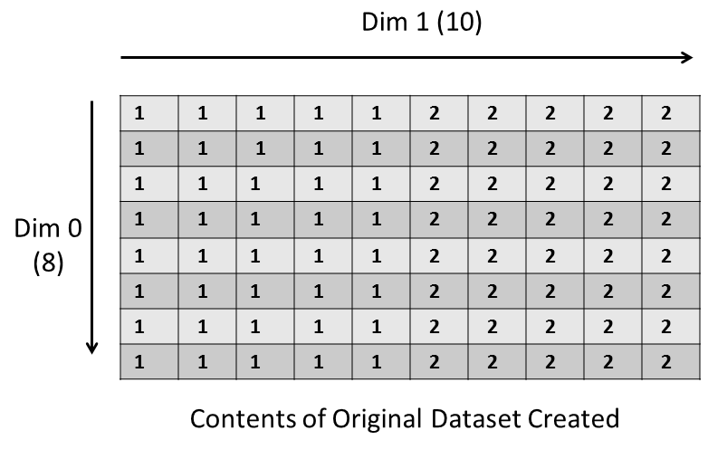
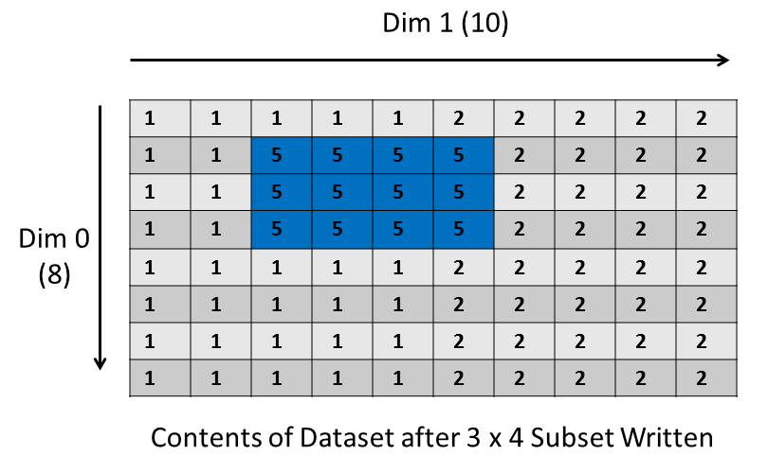
Demo
Creates an 8x10 integer dataset
Selects and writes to a 3x4 subset, offset by 1x2

Slide 54
Thank You! Questions?

